Slide 1
Air Force Institute of Technology
EDM as a Basis for an Intrusion Detection System
2d Lt David Crow
Dr. Scott Graham

Slide 2
Overview
Motivation
Background & related work
Experimental data
Results
Linear data
Nonlinear data
Conclusions & future work

Slide 3
Overview
Motivation
Background & related work
Experimental data
Results
Linear data
Nonlinear data
Conclusions & future work

Slide 4
Motivation
Intrusion detection systems (IDSs) protect vulnerable cyber-physical systems (CPSs) and critical infrastructure.
This research contributes to IDS design.

Slide 5
Motivation
IDS architects require the following:
Insight into the dynamics of a CPS, to include an understanding of the way in which some current state enables predictions concerning a future state
An ample quantity of data obtained under normal operating conditions to establish normal behavior
A process to determine whether new traffic conforms to normal behavior
An alert system to report to the administrator the traffic that does not conform

Slide 6
Motivation
IDS architects require the following:
Insight into the dynamics of a CPS, to include an understanding of the way in which some current state enables predictions concerning a future state
An ample quantity of data obtained under normal operating conditions to establish normal behavior
A process to determine whether new traffic conforms to normal behavior
An alert system to report to the administrator the traffic that does not conform

Slide 7
Overview
Motivation
Background & related work
Experimental data
Results
Linear data
Nonlinear data
Conclusions & future work

Slide 8
Cyber-Physical Systems
“systems where the cyber parts … and the physical parts are tightly integrated, both at the design time and during operation” [1]
Difficult to replicate a CPS’s model ⟶ CPS monitoring
Output of CPS monitoring: time series data

Slide 9
Time Series Data
“(a) Google stock price for 200 consecutive days; (b) Daily change in the Google stock price for 200 consecutive days; (c) Annual number of strikes in the US; (d) Monthly sales of new one-family houses sold in the US; (e) Annual price of a dozen eggs in the US (constant dollars); (f) Monthly total of pigs slaughtered in Victoria, Australia; (g) Annual total of lynx trapped in the McKenzie River district of north-west Canada; (h) Monthly Australian beer production; (i) Monthly Australian electricity production.” [2]

Slide 10
Causality
Relationship between cause and effect
Difficult to measure/quantify
Approximate causality using statistical techniques

Slide 11
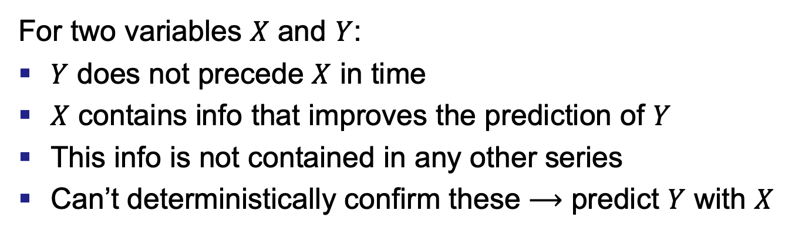
Granger Causality
For two variables $X$ and $Y$:
$Y$ does not precede $X$ in time
$X$ contains info that improves the prediction of $Y$
This info is not contained in any other series
Can’t deterministically confirm these ⟶ predict $Y$ with $X$
[3]

Slide 12
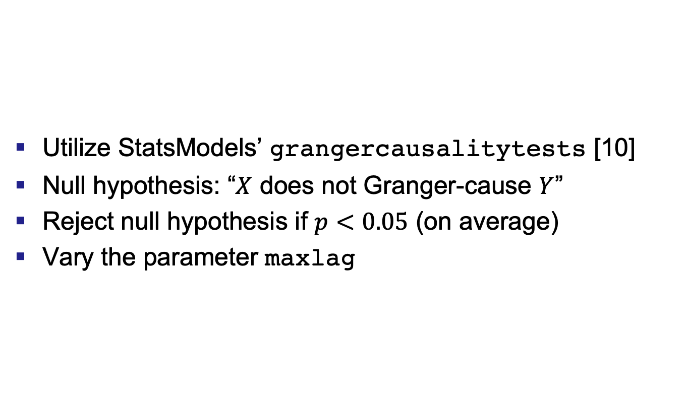
Granger Causality
Utilize StatsModels’ grangercausalitytests [10]
Null hypothesis: “$X$ does not Granger-cause $Y$”
Reject null hypothesis if $p<0.05$ (on average)
Vary the parameter maxlag

Slide 13
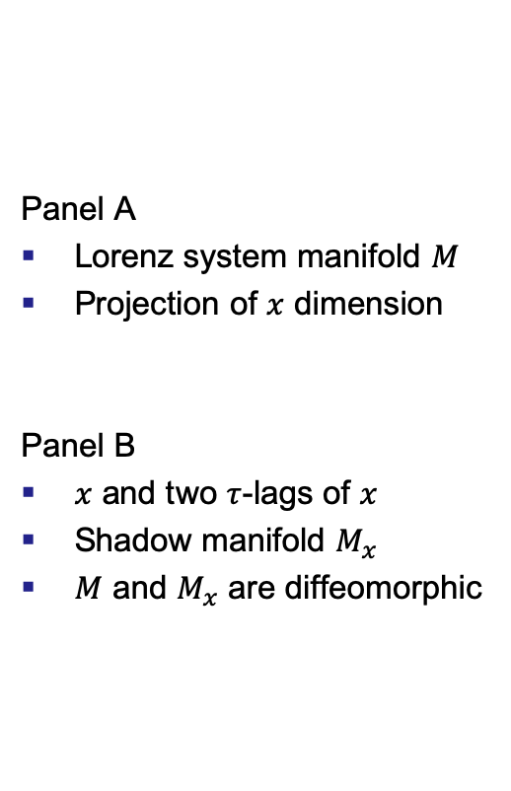
Empirical Dynamic Modeling
Panel A
Lorenz system manifold $M$
Projection of $x$ dimension
Panel B
$x$ and two $τ$-lags of $x$
Shadow manifold $M_{x}$
$M$ and $M_{x}$ are diffeomorphic
[4,5]

Slide 14
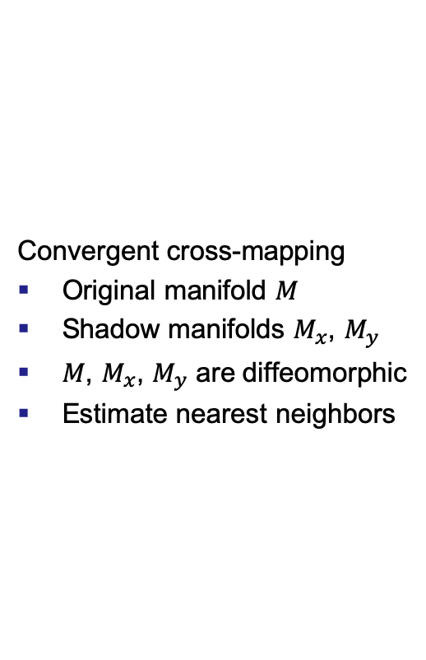
Empirical Dynamic Modeling
Convergent cross-mapping
Original manifold $M$
Shadow manifolds $M_{x}$, $M_{y}$
$M$, $M_{x}$, $M_{y}$ are diffeomorphic
Estimate nearest neighbors
[5,6]

Slide 15
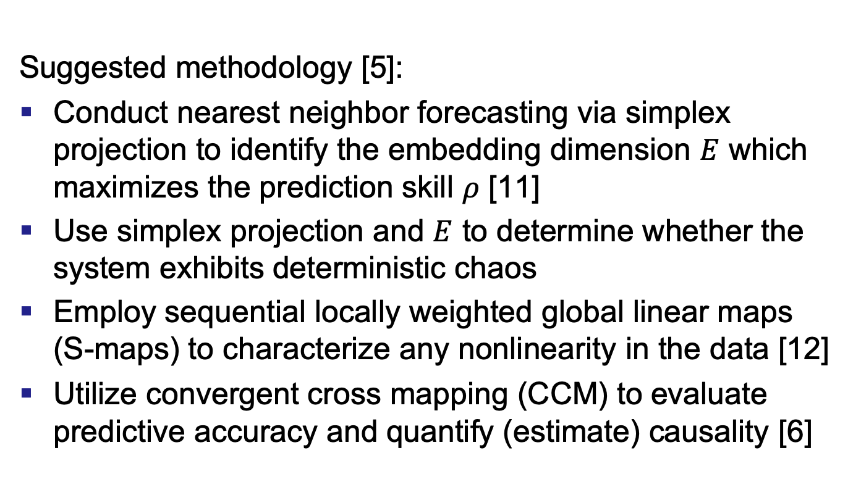
Empirical Dynamic Modeling
Suggested methodology [5]:
Conduct nearest neighbor forecasting via simplex projection to identify the embedding dimension $E$ which maximizes the prediction skill $ρ$ [11]
Use simplex projection and $E$ to determine whether the system exhibits deterministic chaos
Employ sequential locally weighted global linear maps (S-maps) to characterize any nonlinearity in the data [12]
Utilize convergent cross mapping (CCM) to evaluate predictive accuracy and quantify (estimate) causality [6]
Notes:
In essence, “simplex projection is the process of iteratively selecting [a point] Yt in a shadow manifold and b other points whose histories over time t are most similar to the currently selected point ... A simplex is a generalization of a triangle or tetrahedron to an arbitrary number of dimensions” [11, 13, 14]. One then uses the weighted average of the future values of the b other points to make predictions about future values of Yt. The difference between these predictions and the actual future values gives a forecast skill ρ. By repeating this process with shadow manifolds of different dimensionalities, one can identify the embedding dimension E that optimizes ρ [15].
S-map projection is another iterative process, but it instead uses all neighboring points to create linear regression vectors. By aggregating these regression vectors, one approximates an n-dimensional spline. One then compares this spline to the shadow manifold attractor to measure ρ [12, 14, 15]. When generating the regression estimates, a nonlinear tuning parameter θ weights the neighbors with respect to their distance to the current focal point Yt. Finally, “if ρ is maximized when θ = 0, then the time series may be assumed to belong to a simple linear system instead of a dynamic system” [12, 13, 15].

Slide 16
Related Work
Granger causality
Correlate/aggregate alerts to identify important alerts [7]
Determine variables which best predicts an attack [8]
Discover relevant variables prior to specific attack [9]
Empirical dynamic modeling
None!

Slide 17
Overview
Motivation
Background & related work
Experimental data
Results
Linear data
Nonlinear data
Conclusions & future work

Slide 18
Experimental Data: Linear

Slide 19
Experimental Data: Nonlinear

Slide 20
Overview
Motivation
Background & related work
Experimental data
Results
Linear data
Nonlinear data
Conclusions & future work

Slide 21
Results: Linear, Granger

Slide 22
Results: Linear, EDM

Slide 23
Results: Linear, EDM

Slide 24
Results: Linear, EDM

Slide 25
Results: Linear, EDM

Slide 26
Results: Linear, EDM
Time Series | Naive RMSE | EDM RMSE
Steering wheel angle | 0.009424 | 0.003351
Left wheel RPM | 0.005742 | 0.003893
Right wheel RPM | 0.005742 | 0.003893

Slide 27
Results: Linear, EDM

Slide 28
Results: Linear, EDM

Slide 29
Overview
Motivation
Background & related work
Experimental data
Results
Linear data
Nonlinear data
Conclusions & future work

Slide 30
Results: Nonlinear, Granger

Slide 31
Results: Nonlinear, EDM

Slide 32
Results: Nonlinear, EDM

Slide 33
Results: Nonlinear, EDM

Slide 34
Results: Nonlinear, EDM

Slide 35
Results: Nonlinear, EDM
Time Series | Naive RMSE | EDM RMSE
Airspeed | 3.907005 | 0.070161
Altitude | 18.192201 | 0.001535
Pitch | 0.013749 | 0.019748

Slide 36
Results: Nonlinear, EDM

Slide 37
Results: Nonlinear, EDM

Slide 38
Overview
Motivation
Background & related work
Experimental data
Results
Conclusions & future work

Slide 39
Conclusions
Granger causality does not seem to enable effective IDSs
For linear systems, EDM is somewhat limited
For nonlinear systems, EDM may assist in IDS design
Notes:
For linear and nonlinear systems, Granger causality’s limitations ensure that intrusion detection system (IDS) architects should search elsewhere for effective analysis techniques.
Although empirical dynamic modeling (EDM) can quantify behaviors present in linear systems, the results are often limited and so are not likely to aid in the development of IDSs.
For nonlinear systems, EDM is an easy-to-use suite of tools capable of evoking detailed insights that may assist in IDS design.

Slide 40
Future Work
Address the remaining steps towards an IDS
Obtain quality data
Identify whether new traffic obeys expected behavior
Create an administrator alert system
Explore other time series analysis techniques

Slide 41
Summary
Motivation
Background & related work
Experimental data
Results
Conclusions & future work

Slide 42
References
ACM Transactions on Cyber-Physical Systems, “Cyber-Physical Systems (TCPS): About,” 2018. [Online]. Available: https://tcps.acm.org/about.cfm [Accessed: 2019-05-31]
R. J. Hyndman and G. Athanasopoulos, Forecasting: Principles and Practice, 2nd ed. Melbourne, Australia: OTexts, 2018.
BiObserver, “Visualization of Granger causality,” 2014. [Online]. Available: https: //commons.wikimedia.org/wiki/File:GrangerCausalityIllustration.svg [Accessed: 2019-09-27]
Sugihara Lab: Quantitative Ecology and Data-Driven Theory, “Empirical Dynamic Modeling,” 2019. [Online]. Available: http://deepecoweb.ucsd.edu/ nonlinear-dynamics-research/edm/ [Accessed: 2019-05-31]
H. Ye, A. Clarke, E. Deyle, and G. Sugihara, “rEDM: An R package for Empirical Dynamic Modeling and Convergent Cross Mapping,” pp. 1–19, 2019. [Online]. Available: https://cran.r-project.org/web/packages/rEDM/vignettes/rEDM.html [Accessed: 2019- 12-12]
G. Sugihara, R. May, H. Ye, C.-h. Hsieh, E. Deyle, M. Fogarty, and S. Munch, “Detecting Causality in Complex Ecosystems,” Science, vol. 338, no. October, pp. 496–500, 2012.
X. Qin and W. Lee, “Statistical Causality Analysis of Infosec Alert Data,” in International Workshop on Recent Advances in Intrusion Detection. Springer Berlin Heidelberg, 2003, pp. 73–93.
J. B. Cabrera, L. Lewis, X. Qin, W. Lee, R. K. Prasanth, B. Ravichandran, and R. K. Mehra, “Proactive detection of distributed denial of service attacks using MIB traffic variables-a feasibility study,” 2001 7th IEEE/IFIP International Symposium on Integrated Network Management Proceedings: Integrated Management Strategies for the New Millennium, vol. 00, no. c, pp. 609–622, 2001.
J. B. Cabrera, L. Lewis, X. Qin, W. Lee, and R. K. Mehra, “Proactive Intrusion Detection and Distributed Denial of Service Attacks - A Case Study in Security Management,” Journal of Network and Systems Management, vol. 10, no. 2, pp. 225–254, 2002.
J. Perktold, S. Seabold, and J. Taylor, “StatsModels: Statistics in Python,” 2009.
G. Sugihara and R. May, “Nonlinear forecasting as a way of distinguishing chaos from measurement error in time series,” Nature, vol. 344, pp. 734–741, 1990.
G. Sugihara, “Nonlinear forecasting for the classification of natural time series,” Philosophical Transactions of the Royal Society: Mathematical, Physical and Engineering Sciences, vol. 348, no. 1688, 1994.

Slide 43

Questions

